Slide 1
AWS Assessment
By
Shakil Ahamed R
EID : 2116020

Slide 2
PROJECT OBJECTIVES
To create a a secure, scalable, reliable, cost efficient real-time data processing system by integrating
Amazon DynamoDB
AWS Lambda
AWS API Gateway
AWS Java SDK

Slide 3
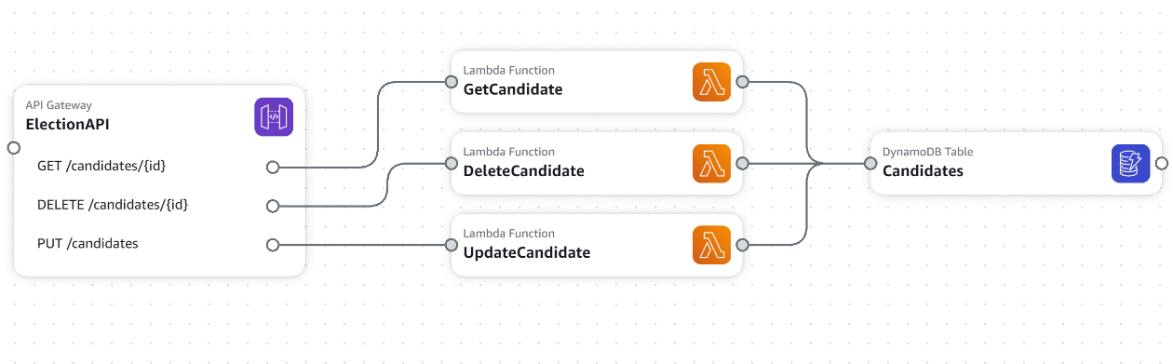
SYSTEM ARCHITECTURE

Slide 4
METHODOLOGY
To reduce the latency and also to keep the cost in check, I used DynamoDB as a Database to store real-time data and AWS Lambda functions will be triggered whenever data is ingested into DynamoDB.
The lambda functions are strategically divided into 3 separate to keep the developer experience high and to make sure only the required code runs thus reducing cost
To make sure the application is always available even during peak loads, but at the same time to keep the aws cost in mind, I used DynamoDB in provisioned mode with autoscaling option thus serving our application purpose fully.
RESTful API are created using AWS API Gateway to allow accessing, modifying, updating and deleting candidates’ data in DynamoDB.

Slide 5
METHODOLOGY
AWS Java SDK is used to for creating, updating and deleting candidates data in DynamoDB which makes the application reliable and secure
To keep the candidates data secure, the data in DynamoDB is encrypted at rest, thus making this solution secure

Slide 6
IMPLEMENTATION DETAILS
Create a DynamoDB table named Candidates with id as partition key
Add an item in the table
Create a Maven project in an IDE and import AWS JAVA Sdk in pom.xml
Create a model class named Candidates.java with getters and setters method
Create a new class named CandidatesLambdaHandler.java
Create a new method named handleRequest() in it and write code to do CRUD operations in DynamoDB using AWS java sdk
Build the code and create a JAR package

Slide 7
IMPLEMENTATION DETAILS
Import the JAR package in AWS lambda and make sure to change the Handler function in AWS console.
Test the Lambda function in AWS console to make sure it works as expected
Now create an API in AWS Gateway named Election-API
Create a new resource called Candidates and then create a new GET method.
Make sure to select AWS Lambda function before created GET method.
Now repeat step 6 to 12 for other lambda functions too
Now we have a application that processes data that is secure, reliable, scalable and cost efficient.

Slide 8
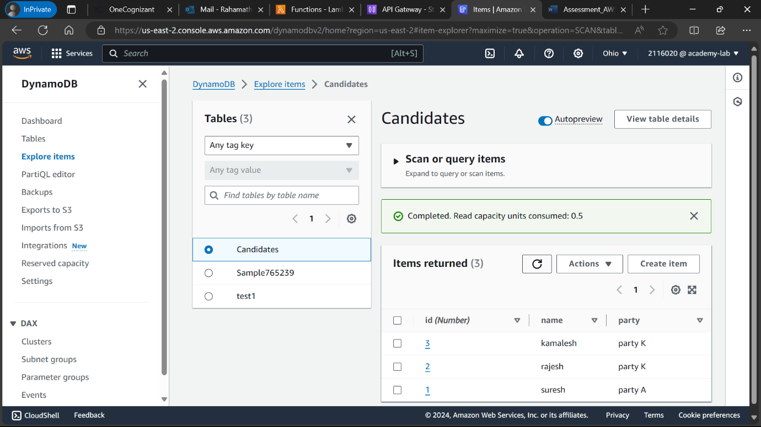
OUTCOMES-AWS DYNAMO DB

Slide 9
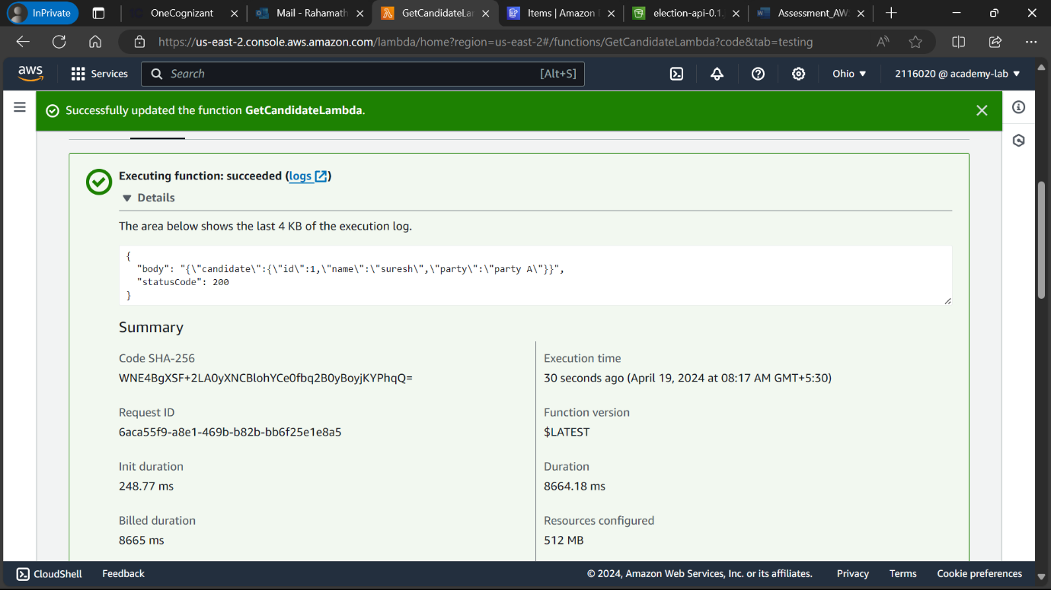
OUTCOMES-AWS LAMBDA

Slide 10
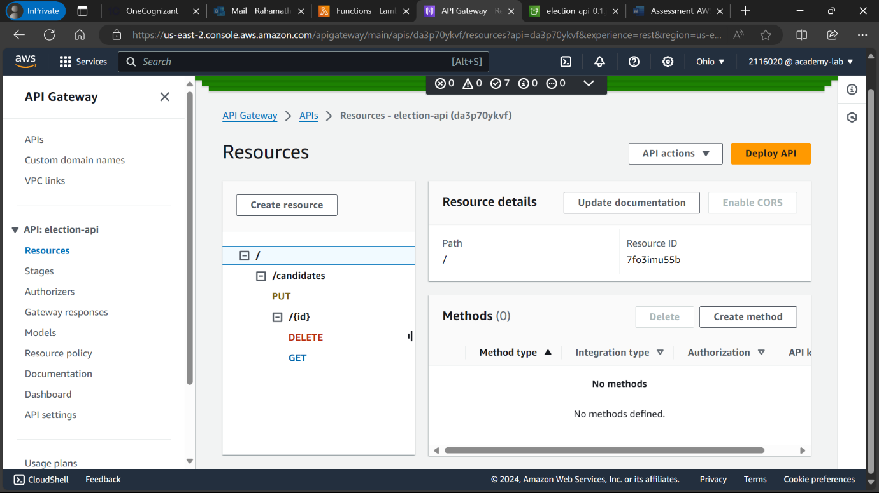
OUTCOMES-AWS API GATEWAY

Slide 11
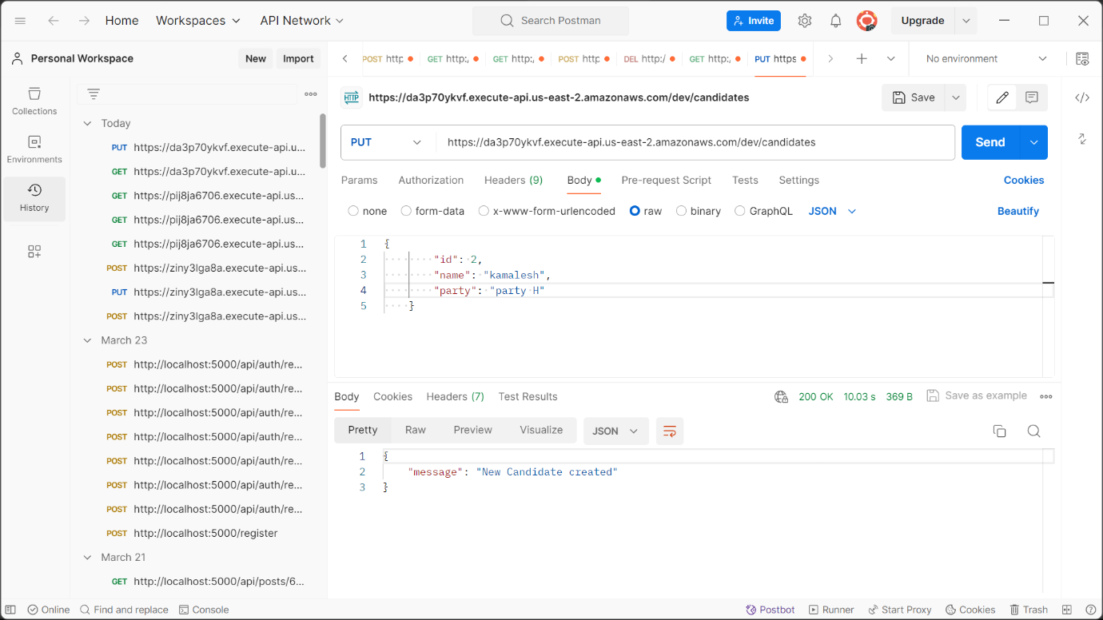
OUTCOMES-POSTMAN

Slide 12
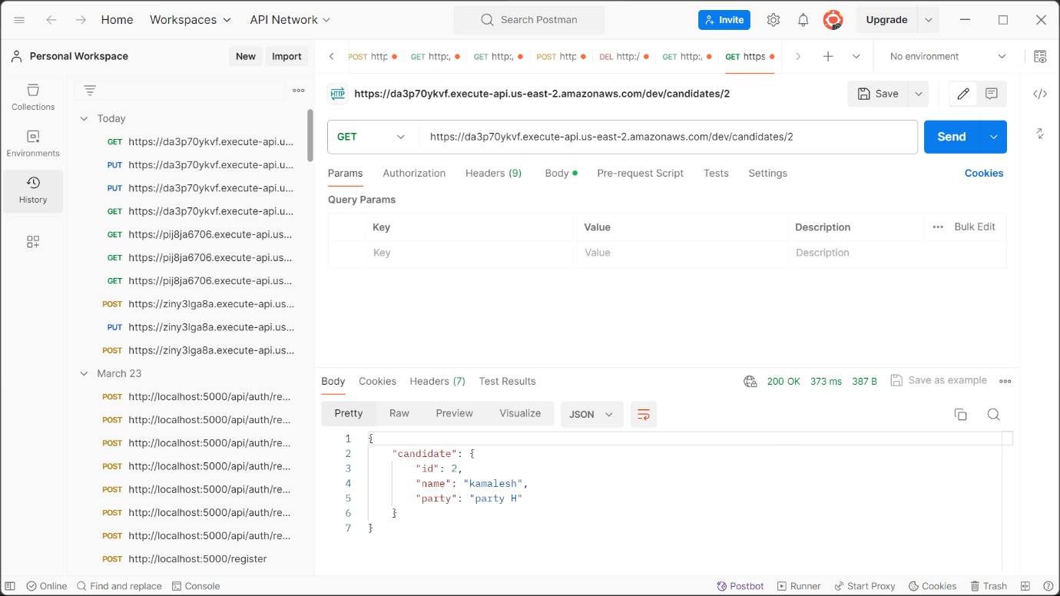
OUTCOMES-POSTMAN

Slide 13
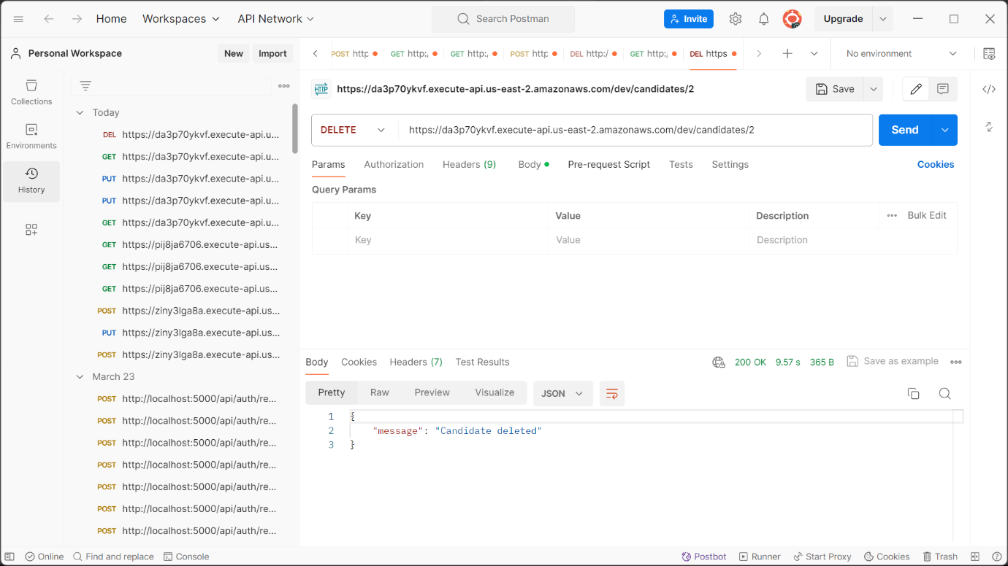
OUTCOME-POSTMAN

Slide 14
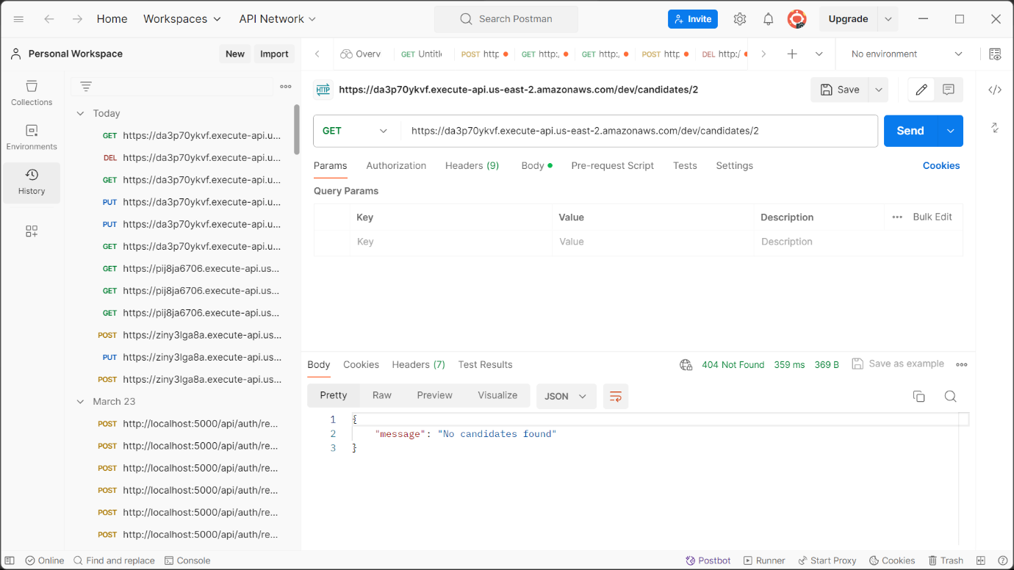
OUTCOMES – POSTMAN

Slide 15
AWS CLOUD FORMATION TEMPLATE

Slide 16
THANK YOU

